Slide 1

GlobalMissionsData GMDeputation Data Structure
7 Feb 2020

Slide 2
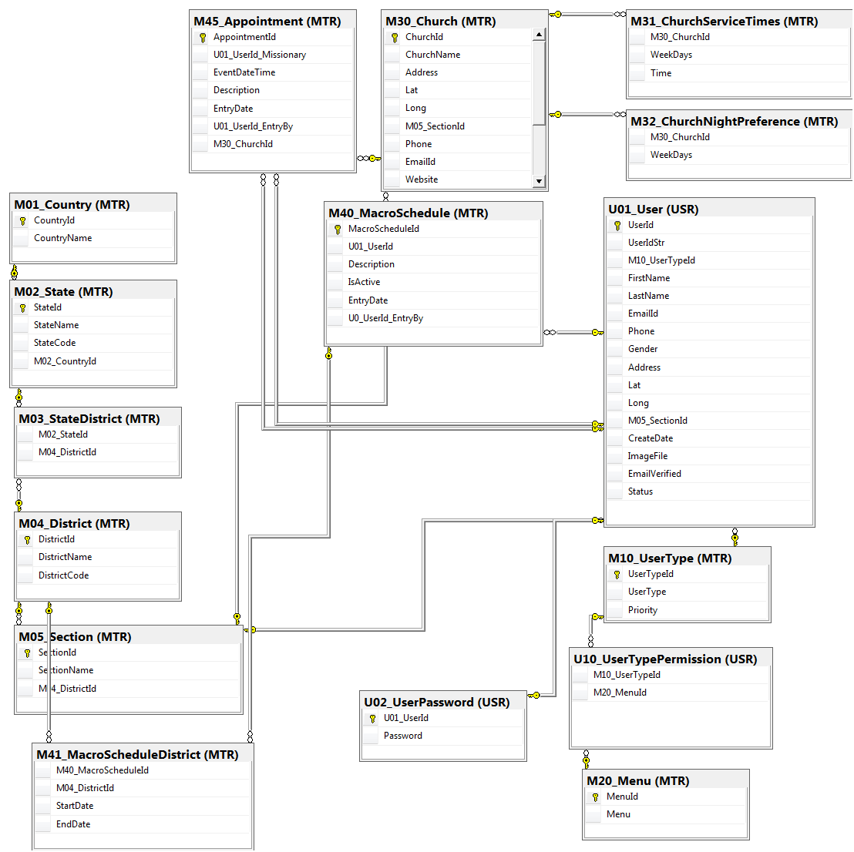
Data Structure
M37_Accom_Appoint
Accom_Use_ID
M33_AccomID
U01_UserID_Missionary
Start_Date_Time
End_Date_Time
Accom_Use_Notes
Missionary_Notes
Missionary_Rating
Accom_Rating
M31_Church_Service_times
M30_ChurchID
Day_of_week (master)
Service_Time
Service_Type (master)
Preference_level
Notes
M30_Church
ChurchID
ChurchName
Address
Lat
Long
M05_SectionID
Phone
EmailID
Website
M31_ChurchServiceTimes
M30_ChurchID
Weekday (master)
Time
RegularYN
Pref_Level
Attributes intended to assist in making church / Missionary linkages, particularly for languages.
Relationships may be better with separate table (e.g. spouse), here is generalized
Languages according to ISO 639-3 to be included in attributes as L_[zzz], where zzz is the language code
Changes shown in RED.
M45_Appointment
AppointmentID
U01_UserID_Missionary
EventDateTime
Description
EntryDate
U01_UserID_EntryBy
M30_ChurchID
PIM_Amt
Offering
Notes
U01_User
UserID
M10_UserTypeID
FirstName
LastName
EmailID
Phone
Gender
Address
Lat
Long
M05_SectionID
CreateDate
ImageFile
EmailVerifiedYN
Status
M01_Country
CountryID
CountyName
M35_PastorChurch
U01_UserID
M30_ChurchID
RelationType
M02_State
StateID
StateName
StateCode
M02_Country
M33_Accommodations
M33_AccomID
M30_ChurchID
AccommType (master)
AccommNotes
M36_AttributeLinking
M07_AttributeID
U01_UserID
Attribute_Value
Notes
M03_StateDistrict
M02_StateID
M01_DistrictID
M06_Attributes
AttributeID
AttributeName
Attribute_Type (master)
AttributeNote
M40_MacroSched
MacroSchedID
U01_UserID?
Description
IsActive
EntryDate
U0_UserID_EntryBy
M04_District
DistrictID
DistrictName
DistrictCode
M41_MacroScheduleDistrict
M40_MacroSchedID
M04_DistrictID
U01_UserID?
StartDate
EndDate
M10_UserType
UserTypeID
UserType (master)
Priority
M05_Section
SectionID
SectionName
M04_DistrictID
U10_UserPermissions
M10_UserTypeID
M20_MenuID
U03_Relationships
U01_UserID
U01_UserID2
Relationship_Type (master)
U02_UserPassword
U01_UserID
Password
M20_Menus
MenuID
Menu

Slide 3
Attributes
Language
Musical_Skill_xyz
M_VehicleType
M_ FaithPromiseYN
M_ EvangQtrRqd_YN
M_ Num_Vehicle
M_ Profile_File
M_ TypeCode
Ministry_type_xyz
Birth_origin
…

Slide 4
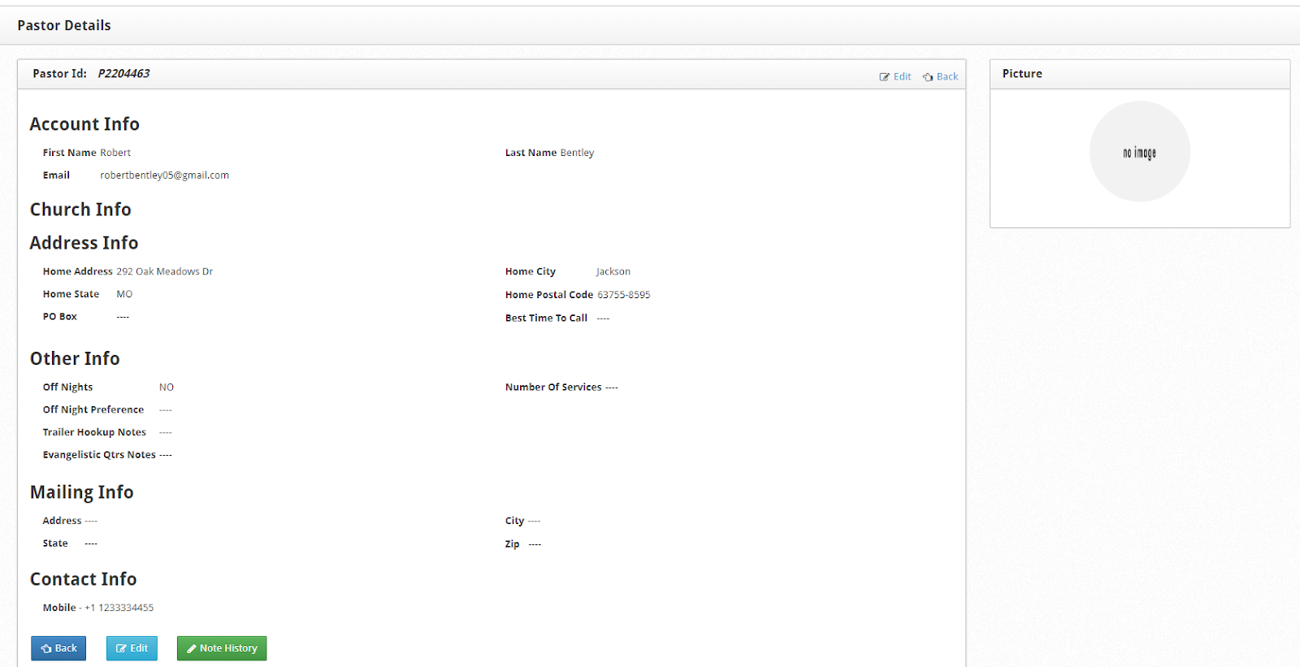
M30_Church
ChurchID
ChurchName
Address
Lat
Long
M05_SectionID
Phone
EmailID
Website
M31_ChurchServiceTimes
M30_ChurchID
Weekday
Time
RegularYN
Pref_Level
M45_Appointment
AppointmentID
U01_UserID_Missionary
EventDateTime
Description
EntryDate
U01_UserID_EntryBy
M30_ChurchID
U01_User
UserID
M10_UserTypeID
FirstName
LastName
EmailID
Phone
Gender
Address
Lat
Long
M05_SectionID
CreateDate
ImageFile
EmailVerifiedYN
Status
M_VehicleType
M_ FPromiseYN
M_ EQ_YN
M_ Num_Vehicle
M_ Profile_File
M_ TypeCode
M01_Country
CountryID
CountyName
M35_PaatorChurch
U01_UserID
M30_ChurchID
RelationType
Old
M02_State
StateID
StateName
StateCode
M02_Country
M33_Accommodations
M30_ChurchID
AccommType
AccommNotes
M36_AttributeLinking
M07_AttributeID
U01_UserID
Attribute_Strength
Notes
M03_StateDistrict
M02_StateID
M01_DistrictID
M06_Attributes
AttributeID
AttributeName
AttributeNote
M40_MacroSched
MacroSchedID
Description
IsActive
EntryDate
U0_UserID_EntryBy
M04_District
DistrictID
DistrictName
DistrictCode
M05_MacroScheduleDistrict
M40_MacroSchedID
M04_DistrictID
StartDate
EndDate
M10_UserType
UserTypeID
UserType
Priority
M05_Section
SectionID
SectionName
M04_DistrictID
U10_UserPermissions
M10_UserTypeID
M20_MenuID
U02_UserPassword
U01_UserID
Password
M20_Menus
MenuID
Menu

Slide 5
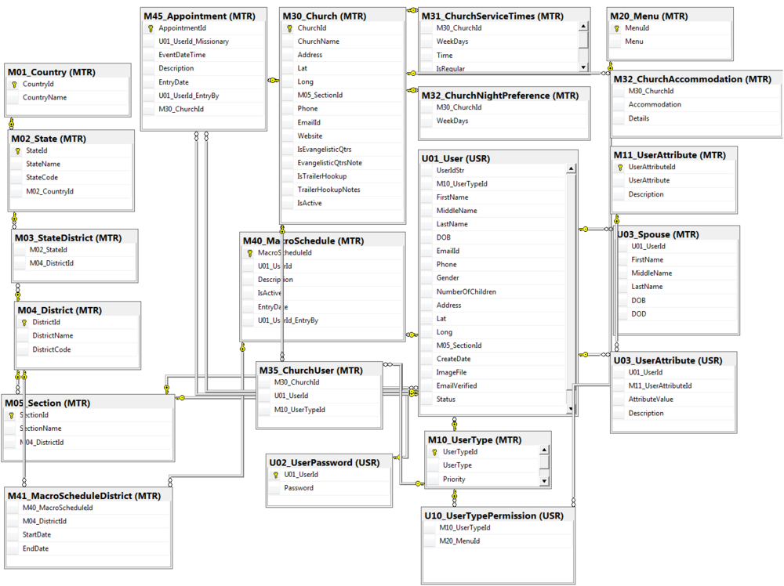
Old 2

Slide 6
Proposed Structure – 27 Jan 20
Generic Tables reused for each location type
Table Links not correctly- fully defined

Slide 8
M30_Church
ChurchID
ChurchName
Address
Lat
Long
M05_SectionID
Phone
EmailID
Website
M31_ChurchServiceTimes
M30_ChurchID
Weekday (master)
Time
RegularYN
Pref_Level
M45_Appointment
AppointmentID
U01_UserID_Missionary
EventDateTime
Description
EntryDate
U01_UserID_EntryBy
M30_ChurchID
PIM_Amt
Offering
Notes
U01_User
UserID
M10_UserTypeID
FirstName
LastName
EmailID
Phone
Gender
Address
Lat
Long
M05_SectionID
CreateDate
ImageFile
EmailVerifiedYN
Status
M01_Country
CountryID
CountyName
M35_PastorChurch
U01_UserID
M30_ChurchID
RelationType
M02_State
StateID
StateName
StateCode
M02_Country
M33_Accommodations
M30_ChurchID
AccommType (master)
AccommNotes
M36_AttributeLinking
M07_AttributeID
U01_UserID
Attribute_Value
Notes
M03_StateDistrict
M02_StateID
M01_DistrictID
M06_Attributes
AttributeID
AttributeName
Attribute_Type (master)
AttributeNote
M40_MacroSched
MacroSchedID
U01_UserID?
Description
IsActive
EntryDate
U0_UserID_EntryBy
M04_District
DistrictID
DistrictName
DistrictCode
M05_MacroScheduleDistrict
M40_MacroSchedID
M04_DistrictID
U01_UserID?
StartDate
EndDate
M10_UserType
UserTypeID
UserType (master)
Priority
M05_Section
SectionID
SectionName
M04_DistrictID
U10_UserPermissions
M10_UserTypeID
M20_MenuID
U03_Relationships
U01_UserID
U01_UserID2
Relationship_Type (master)
U02_UserPassword
U01_UserID
Password
M20_Menus
MenuID
Menu

Slide 9
M30_Church
ChurchID
ChurchName
Address
Lat
Long
M05_SectionID
Phone
EmailID
Website
M31_ChurchServiceTimes
M30_ChurchID
Weekday (master)
Time
RegularYN
Pref_Level
M45_Appointment
AppointmentID
U01_UserID_Missionary
EventDateTime
Description
EntryDate
U01_UserID_EntryBy
M30_ChurchID
PIM_Amt
Offering
Notes
U01_User
UserID
M10_UserTypeID
FirstName
LastName
EmailID
Phone
Gender
Address
Lat
Long
M05_SectionID
CreateDate
ImageFile
EmailVerifiedYN
Status
M01_Country
CountryID
CountyName
M35_PastorChurch
U01_UserID
M30_ChurchID
RelationType
M02_State
StateID
StateName
StateCode
M02_Country
M33_Accommodations
M30_ChurchID
AccommType (master)
AccommNotes
M36_AttributeLinking
M07_AttributeID
U01_UserID
Attribute_Value
Notes
M03_StateDistrict
M02_StateID
M01_DistrictID
M06_Attributes
AttributeID
AttributeName
Attribute_Type (master)
AttributeNote
M40_MacroSched
MacroSchedID
U01_UserID?
Description
IsActive
EntryDate
U0_UserID_EntryBy
M04_District
DistrictID
DistrictName
DistrictCode
M05_MacroScheduleDistrict
M40_MacroSchedID
M04_DistrictID
U01_UserID?
StartDate
EndDate
M10_UserType
UserTypeID
UserType (master)
Priority
M05_Section
SectionID
SectionName
M04_DistrictID
U10_UserPermissions
M10_UserTypeID
M20_MenuID
U03_Relationships
U01_UserID
U01_UserID2
Relationship_Type (master)
U02_UserPassword
U01_UserID
Password
M20_Menus
MenuID
Menu

Slide 10
Data interfaces
M31_Church_Service_times
M30_ChurchID
Day_of_week
Service_Time
Service_Type
Preference_level
Notes
M30_Church
ChurchID
ChurchName
Address
Lat
Long
M05_SectionID
Phone
EmailID
Website
M31_ChurchServiceTimes
M30_ChurchID
Weekday
Time
RegularYN
Pref_Level
Main interface is to UPCI HQ, via User Table for Missionaries (Global Missions)
Possible link respective to Pastors and Churches. Data integrity aspects must be managed here (NAM?)
M45_Appointment
AppointmentID
U01_UserID_Missionary
EventDateTime
Description
EntryDate
U01_UserID_EntryBy
M30_ChurchID
PIM_Amt
Offering
Notes
U01_User
UserID
M10_UserTypeID
FirstName
LastName
EmailID
Phone
Gender
Address
Lat
Long
M05_SectionID
CreateDate
ImageFile
EmailVerifiedYN
Status
M01_Country
CountryID
CountyName
M35_PastorChurch
U01_UserID
M30_ChurchID
RelationType
M02_State
StateID
StateName
StateCode
M02_Country
M33_Accommodations
M30_ChurchID
AccommType
AccommNotes
M36_AttributeLinking
M07_AttributeID
U01_UserID
Attribute_Value
Notes
M03_StateDistrict
M02_StateID
M01_DistrictID
M06_Attributes
AttributeID
AttributeName
Attribute_Type
AttributeNote
M40_MacroSched
MacroSchedID
Description
IsActive
EntryDate
U0_UserID_EntryBy
M04_District
DistrictID
DistrictName
DistrictCode
M05_MacroScheduleDistrict
M40_MacroSchedID
M04_DistrictID
StartDate
EndDate
M10_UserType
UserTypeID
UserType
Priority
M05_Section
SectionID
SectionName
M04_DistrictID
U10_UserPermissions
M10_UserTypeID
M20_MenuID
U03_Relationships
U01_UserID
U01_UserID2
Relationship_Type
U02_UserPassword
U01_UserID
Password
M20_Menus
MenuID
Menu

